Slide 1
A Recommender System for Exploratory Browsing
Team: SPARA
Tutor: Tommaso Di Noia

Slide 2
Exploratory browsing
Multiple domains
Serendipitous
Following links

Slide 3

Content-based Recommender Systems
CB-RSs recommend items to a user based on their description and on the profile of the user’s interests
User profile
Recommender System
Item | Rating
Movie A | 9/10
Actor J | 5/10
Movie C | 7/10
Top-N Recommendations
Item1, 5
Item2, 1
Item5, 4
Item10, 5
….
…
Recommendation
Movie 1
Movie 2
Movie 3
Items
Movie D
….
Movie A
Properties
Director: Steven Spielberg
Starring: Justin Bieber
…
Movie K
Slide: Tommaso Di Noia

Slide 4
The LOD Aspects
Subgraph of DBpedia with different types of items (Film, Person, Book) using SPARQL
Rich set of features - DBpedia properties associated to a type
Links to related items
Generate user profiles with ratings from IMDB
IMDB to DBpedia URI mapping
Inferring ratings for persons related to movies
Feed the data to the recommender system
Notes:
Dbpedia properties: Linked Data mitigates the limited content analysis issue

Slide 5
User Interfaces

Slide 6
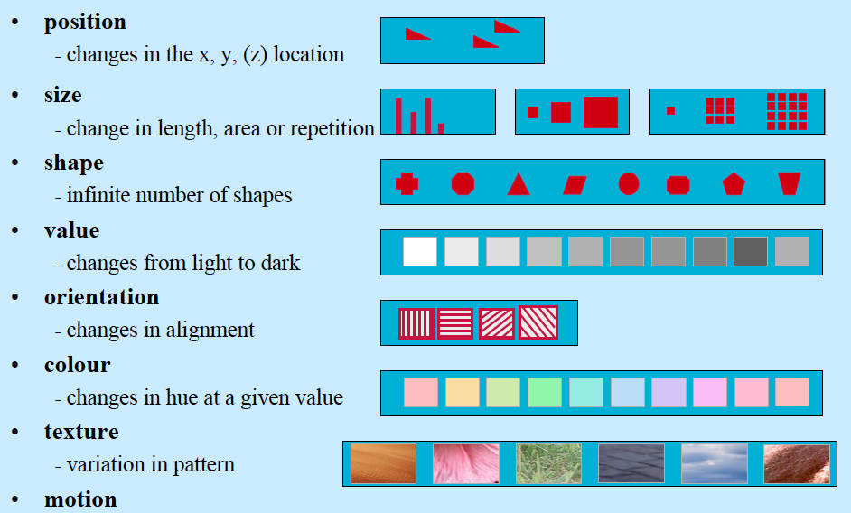
Bertin’s Visual Attributes
Bertin, Semiology of Graphics, 83
Slide: Sheelagh Carpendale

Slide 7
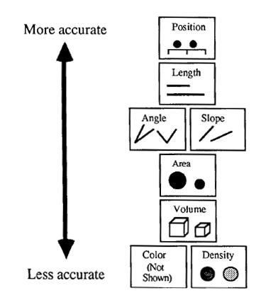
Importance Ordering: Perceptual Properties
Mackinlay, APT (A Presentation Tool), 1986
Slide: Cecilia Aragon, HCDE, UW
Notes:
Importance Ordering: Encode the most important information in the most perceptually accurate way

Slide 8
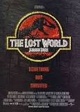
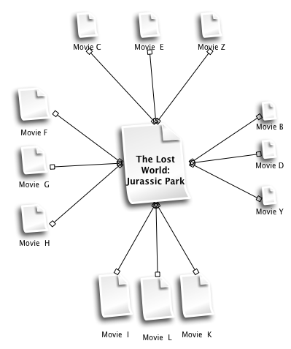
Movies Perspective
The Lost World: Jurassic Park
The Lost World: Jurassic Park, is a 1997 American science fiction adventure film directed by Steven Spielberg and the second of the Jurassic Park franchise. The film was produced by Gerald R. Molen and Colin Wilson.
Director: Steven Spielberg
Starring: Jeff Goldblum, Julianne Moore, Richard Attenborough, Vince Vaughn, Pete Postlethwaite
Notes:
Importance Ordering: Encode the most important information in the most perceptually accurate way

Slide 9
Demo

Slide 10
Future work

Slide 11
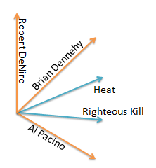
Parameter Tuning
Righteous Kill
Heat
Righteous Kill
starring
Heat
Brian Dennehy
Al Pacino
… …
Robert De Niro
genre
subject/broader
director
starring
Drama
Robert De Niro
Al Pacino
John Avnet
Crime films
Brian Dennehy
Serial killer films
Heist films
Slide: Tommaso Di Noia

Slide 12
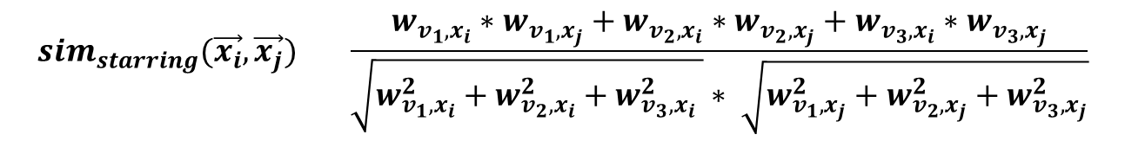




Vector Space Model for LOD
$$sim_{starring}(\vec{x_{i}},\vec{x_{j}}) ={\frac{w_{v_{1},x_{i}}∗w_{v_{1},x_{j}}+w_{v_{2},x_{i}}∗w_{v_{2},x_{j}}+w_{v_{3},x_{i}}∗w_{v_{3},x_{j}}}{\sqrt{w_{v_{1},x_{i}}^{2}+w_{v_{2},x_{i}}^{2}+w_{v_{3},x_{i}}^{2} }∗ \sqrt{w_{v_{1},x_{j}}^{2}+w_{v_{2},x_{j}}^{2}+w_{v_{3},x_{j}}^{2}}}}$$
$$α_{starring}∗sim_{starring}(\vec{x_{i}},\vec{x_{j}})$$
+
$$α_{director}∗sim_{director}(\vec{x_{i}},\vec{x_{j}})$$
+
$$α_{subject}∗sim_{subject}(\vec{x_{i}},\vec{x_{j}})$$
+
… =
$$sim_{starring}(\vec{x_{i}},\vec{x_{j}})$$
Slide: Tommaso Di Noia

Slide 13
Evaluate
Experimenting with the α_{p} parameters
Learning α_{p}
Quality of the recommendations
Discounted cumulative gain
Kendall tau rank correlation coefficient
Precision and Recall
Precision = true positive/ number of predicted positive
Recall = true positive / number of actual positive
Notes:
Tau: a measure of rank correlation, i.e., the similarity of the orderings of the data when ranked by each of the quantities.
DCG: Using a graded relevance scale of documents in a search engine result set, DCG measures the usefulness, or gain, of a document based on its position in the result list.

Slide 14
Evaluating the user interfaces
Explanations
Generating explanations
Evaluating explanations

Slide 15
Thank You

